Slide 1
Space Weather and ionospheric storms –
Researcher’s viewpoint
Kirsti Kauristie, Finnish Meteorological Institute
Special Thanks: J. Norberg (FMI),
A. Aikio and T. Nygren (University of Oulu)

Slide 2
Contents
Space weather: What and why?
Interesting processes and structures in the ionosphere
Probing ionosphere with radio waves
Why forecasting is difficult?

Slide 3
Space weather

Slide 4
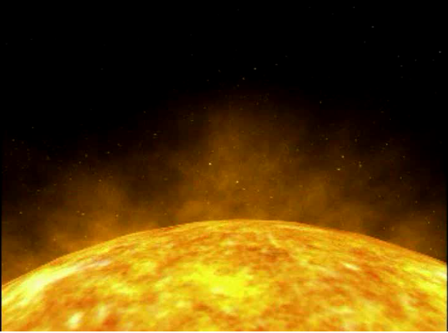
The impact of Solar eruption in the near-Earth space
Excerpt from an animation by NASA

Slide 5

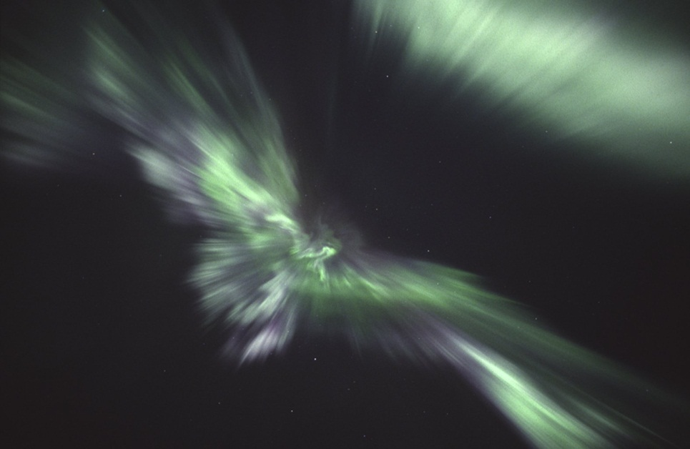
Space weather has two faces
Solar eruptions cause rapid variations in the magnetospheric and ionospheric conditions
Geomagnetic field guides processes particularly to the vicinity of magnetic poles
Manifestations:
  Beautiful auroras
  Potential problems in technology on ground and in space
Photo: Jouni Jussila

Slide 6
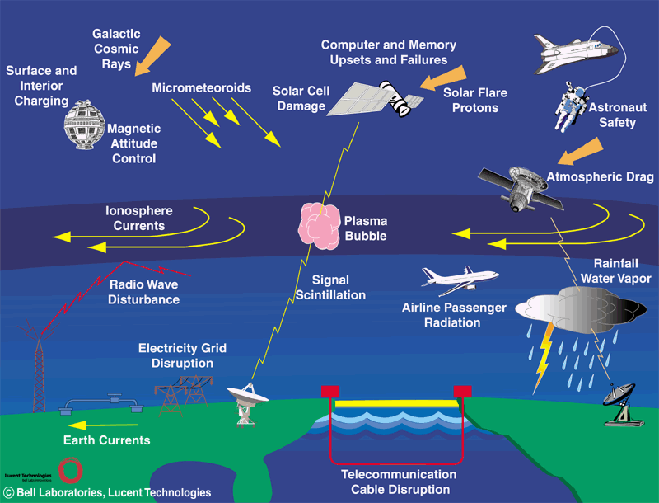
Space weather: Societal impact

Slide 7
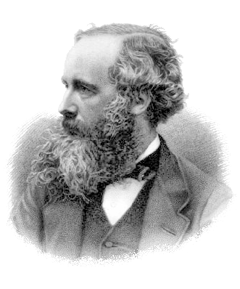
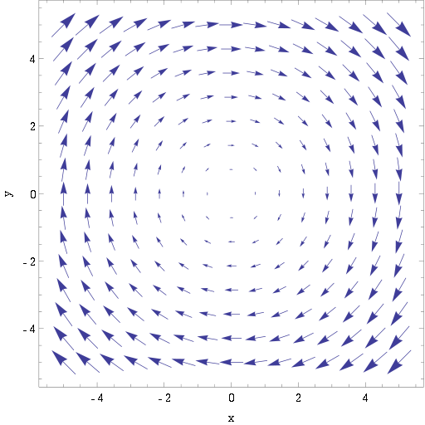
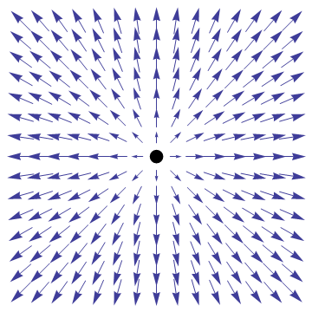
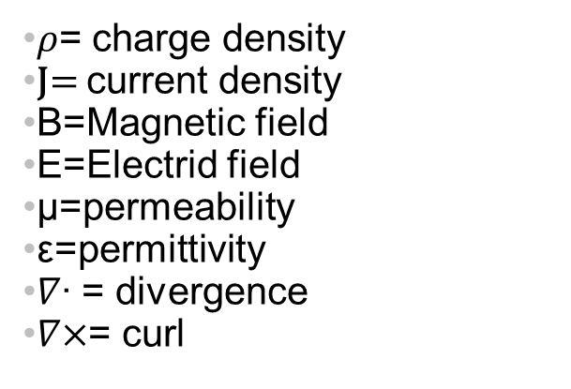
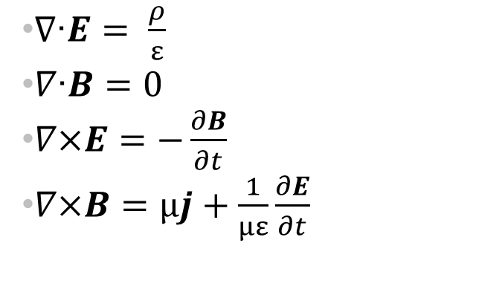
The Maxwell equations
$∇\text{∙}E= \frac{ρ}{ε}$
$∇\text{∙}B=0$
$∇\text{×}E=−\frac{∂B}{∂t}$
$∇\text{×}B=µj+\frac{1}{µε}\frac{∂E}{∂t}$
𝜌= charge density
J= current density
B=Magnetic field
E=Electrid field
µ=permeability
ε=permittivity
$∇\text{∙}$ = divergence
$∇\text{×}$= curl
James Clerk Maxwell
Scottish mathematician
1831-1879

Slide 8
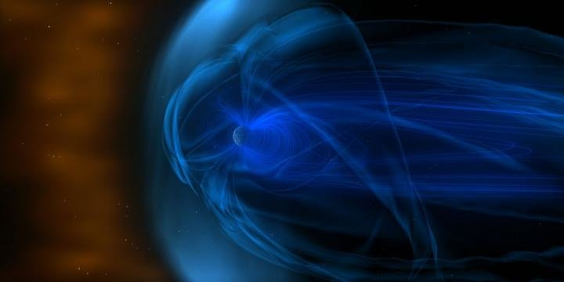
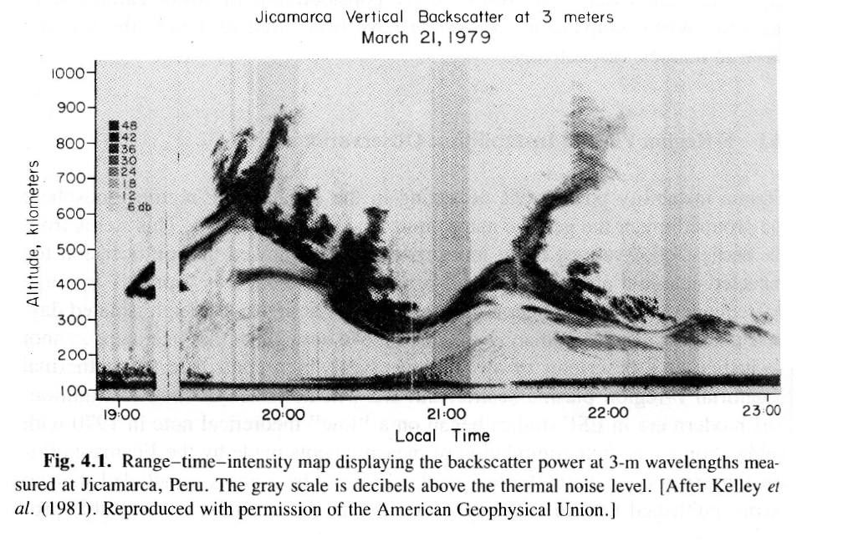
Plasma and its waves
Maxwell: Electric and magnetic fields, charges and currents are coupled with each other
Plasma: dilute gas with charged particles where the above described coupling is exceptionally pronounced.
Disturbances in plasma can grow rapidly and they often appear as waves.
Plasma is the dominant state of matter in the space.
In the ionosphere plasma is mixed with the neutral atmosphere which makes its modelling challenging

Slide 9
Ionosphere

Slide 10
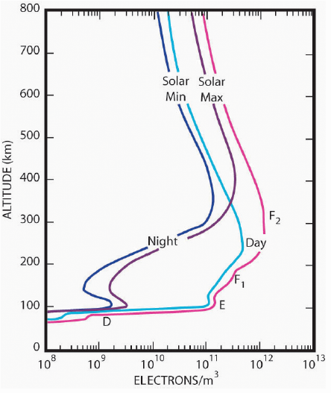
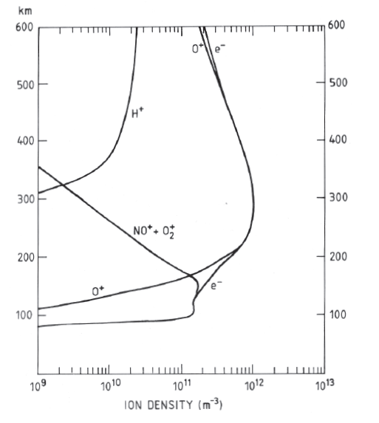
The structure of ionosphere
Three layers: F, E, D
Variations in the electron density
  Day-night variations: 100x
  Variations according to the solar cycle: 10x in upper parts of F-layer
  Auroras: 100x variability in E-layer
Radio signals reflect
Auroras
Radio signals can disappear

Slide 11
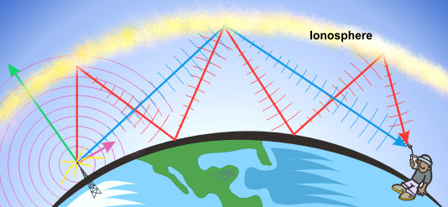
Factors controlling ionospheric electron density
Solar illumination
EUV, X-rays
Energetic particles
Auroral particles
Plasma drift
Plasma drift
Loss of charge into the
neutral atmosphere
(recombination)

Slide 12
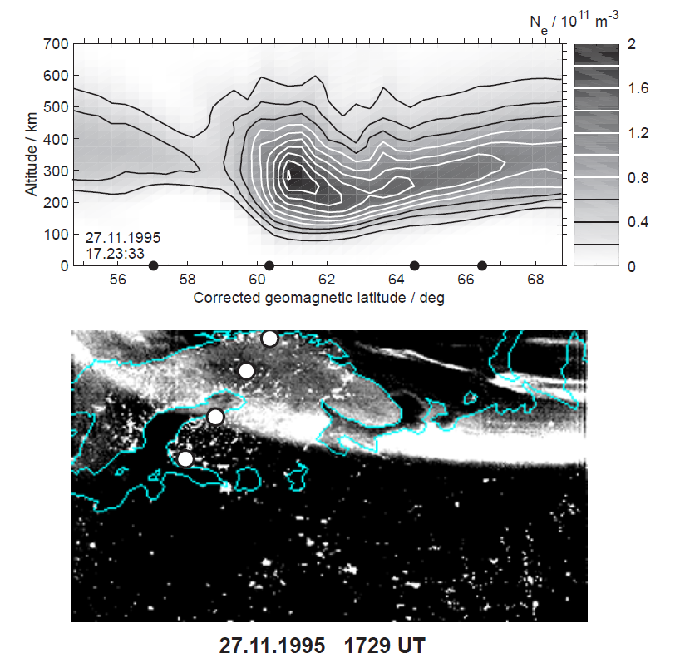
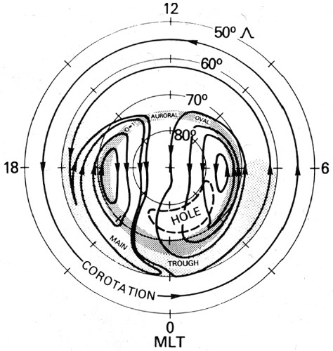
Mid-latitude trough
A ”ditch” at the equatorward boundary of the auroral oval where electron density is low.
Factors causing the trough
  Global plasma circulation (magnetospheric driving + Earth’s rotation)
  Recombination is eating plasma in the regions of slow circulation

Slide 13
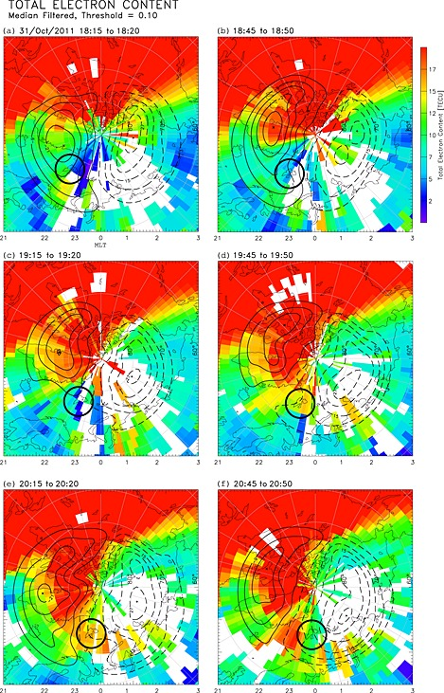
Tongue of Ionization:
High latitude
plasma circulation
sucks dense plasma
from dayside ionosphere
to the polar cap
Figure:
Van Der Meeren, et al.
JGR, 2014

Slide 14
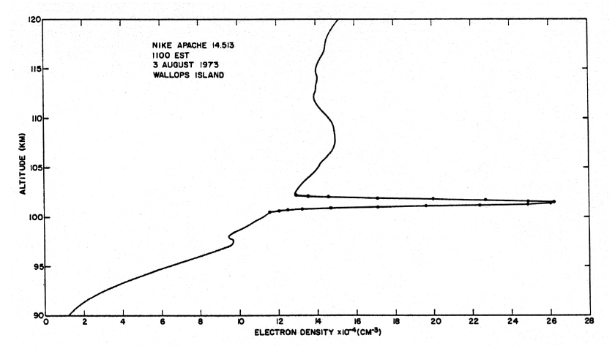
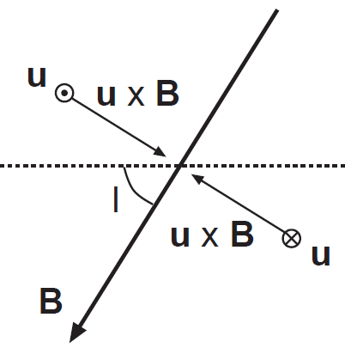
Sporadic E-layer
A thin layer in the ionosphere where plasma density is extremely high
Resulting from plasma drifts in vertical direction
A slow process, ions with long living times are needed
Metallic ions (Fe+ ja Mg+) have a central role
Large scale neutral winds collect metallic ions in certain regions
Small scale neutral wind make the sporadic structures
Different generation mechanisms at mid- and high- latitudes
1-2 km
2-10 times the background
density
Altitude profile of plasma density measured by a rocket
Neutral wind to
west
Force pushing
The metallic ions
Altitude

Slide 15
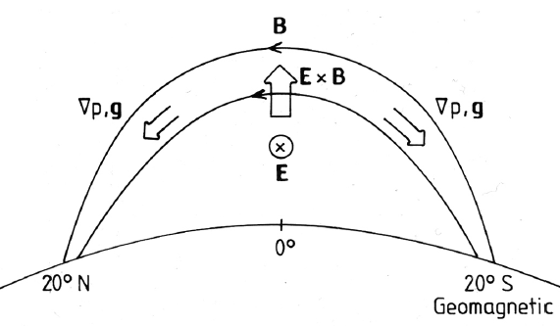
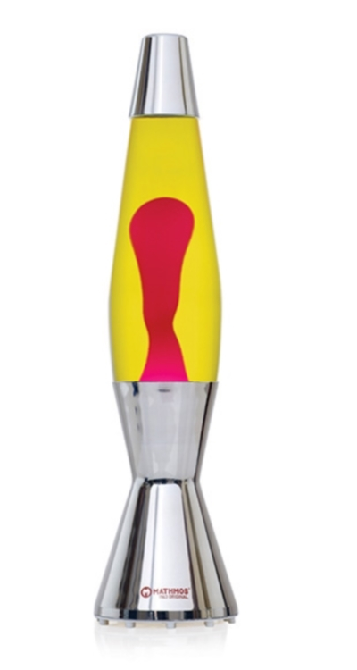
Equatorial fountain and plasma bubbles
Solar radiatio generates a westward electric field at the equator
The magnetic field is horizontal
The electric and magnetic fields together push plasma upwards
Plasma moves along the geomagnetic field lines to zones northward and southward of the equator.
After sunset recombination starts to eat plasma, slower at higher altitudies
→ more dilute plasma build up under dense plasma
→ plasma bubbles appear

Slide 16
Probing with radio waves

Slide 17
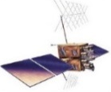
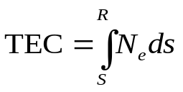
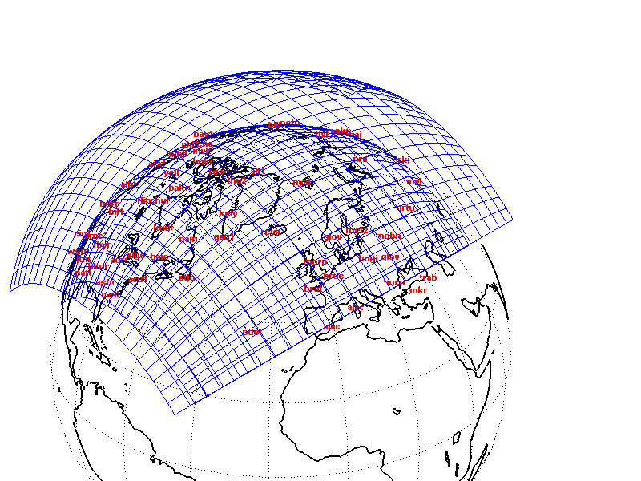
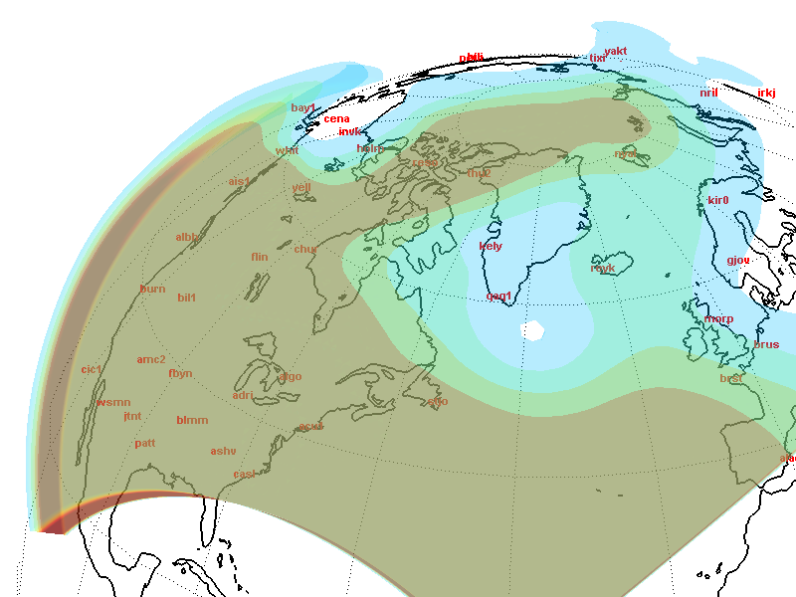
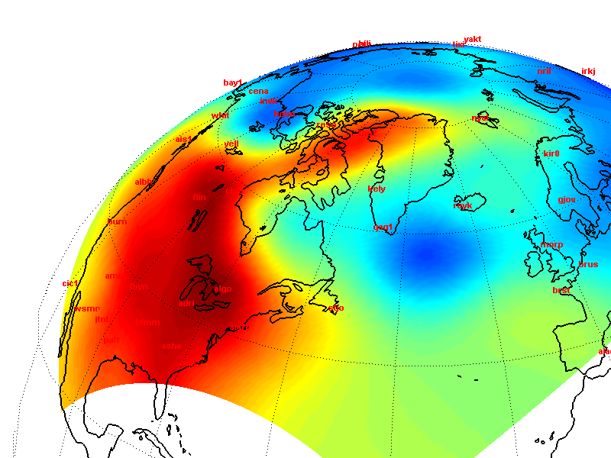
Dense GNSS receiver networks are widely used in ionospheric research
Ionospheric impact on GNSS signal: refraction, phase of carrier gets advanced and that of code gets delayed.
From the combination of L1 and L2 signals integrated electron density (N_{e}) along the signal path can be deduced
Near-Real-time data available from several networks → Suitable approach also for operational services
Works well particularly at low and middle latitudes and in global scales
3D
2D
Altitude integration
Figures: Pokhotelov et al, 2010

Slide 18
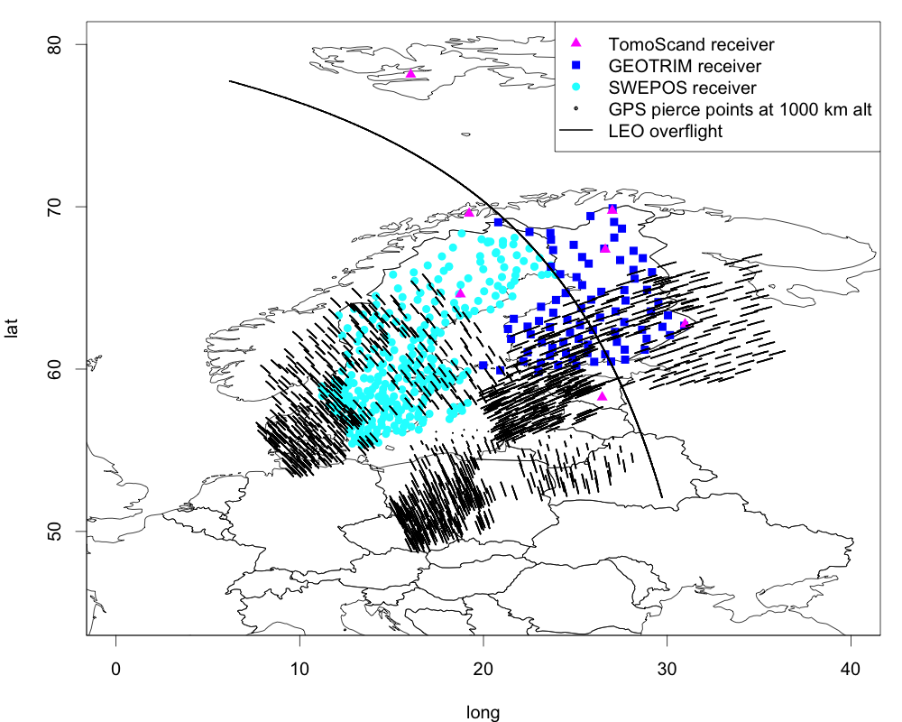
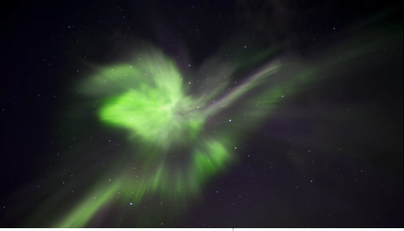
Challenges in the Arctic ionosphere
Auroral activity causes dynamic small scale structures in the ionosphere → high space and time resolution needed
GNSS signals available only at low elevation angles → less information from the regions where the disturbances are strongest
Excerpt from a video by Sauli Koski

Slide 19
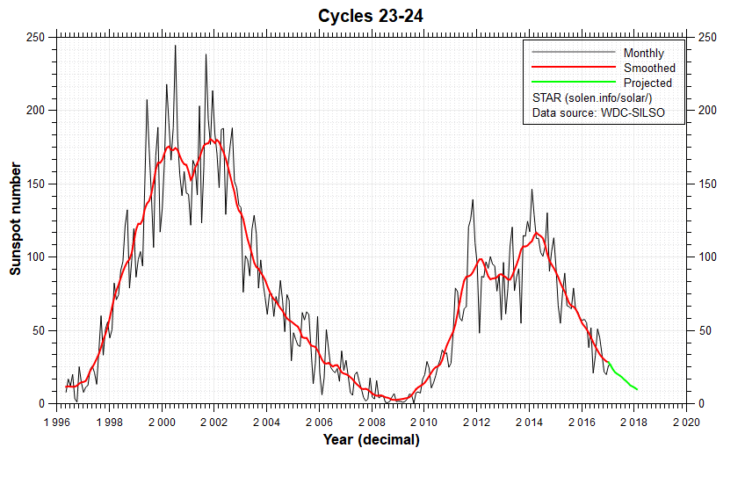
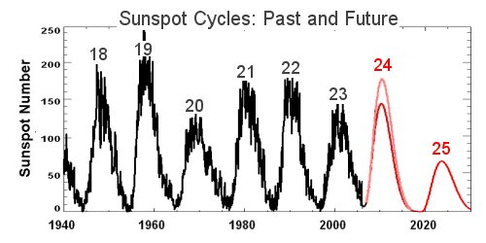

Slide 20

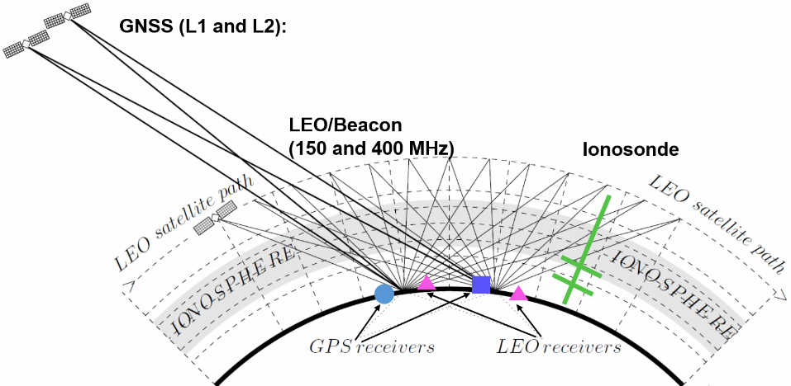
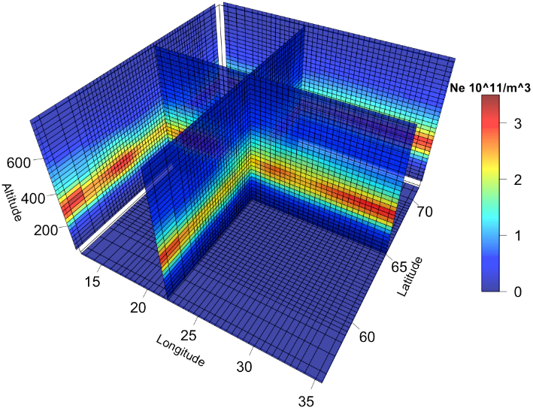
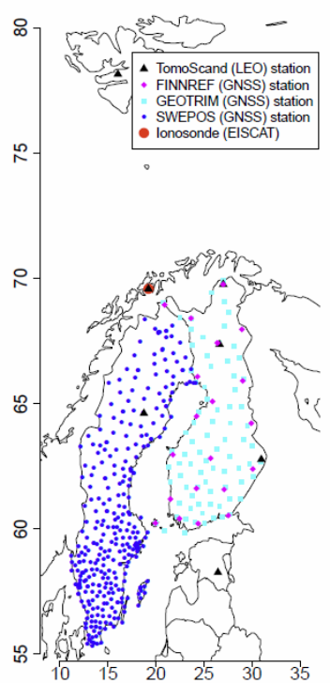
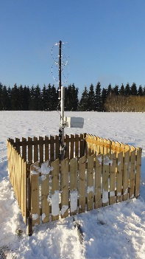
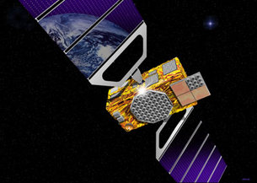
TomoScand – IONOSPHERIC TOMOGRAPHY
3D reconstruction for ionospheric electron density (Ne) over Fennoscandia
Spatial resolution 5-20 km (typically ~100 km in global inversions)
Input: GNSS and LEO/Beacon signals
Bayesian statistical inversion
3D image of electron density
GNSS: Continuous signal but limited in latitude and elevation angle
Beacon: A snapshot over the whole area with a range of elevation angles but available only ~4 times per day

Slide 21
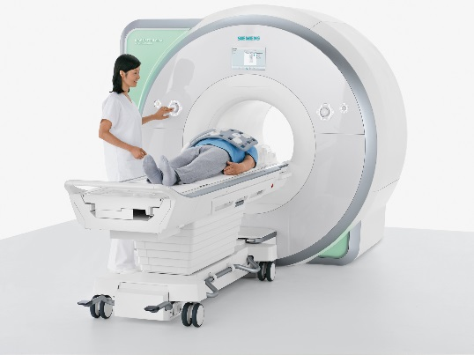
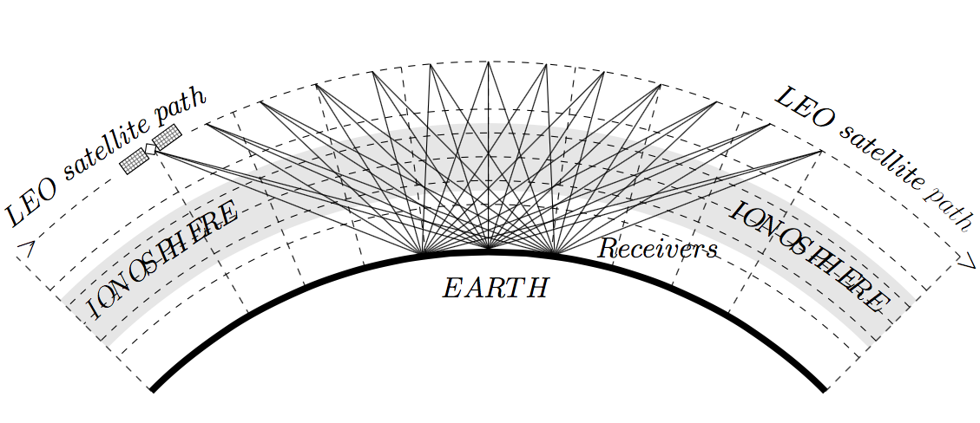
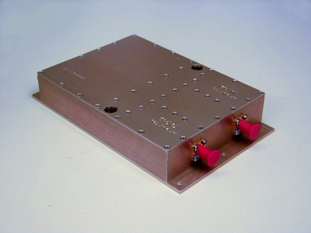
TomoScand approach – pros and cons
Challenges
  Signal paths do not cover all directions → support from other instrumentation needed
  Availability of Beacon transmissions in the future?
Advantages
  High space resolution
  Understandable regularization of the ill-posed problem
  Systematic error estimates
  Cheap technology, tested already in CubeSats
Figures: J. Norberg; Syntech Microwave; IBIMAGEM

Slide 22
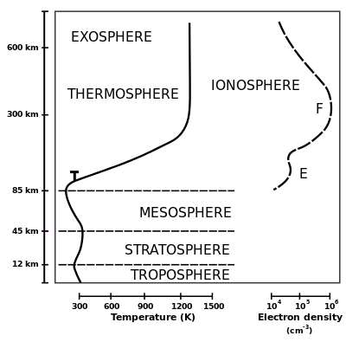
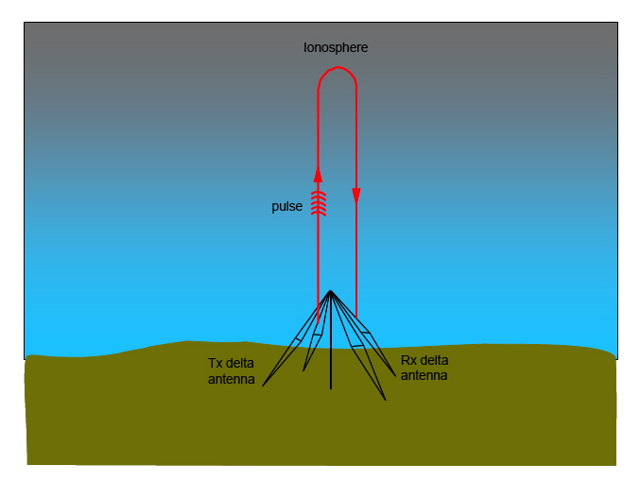
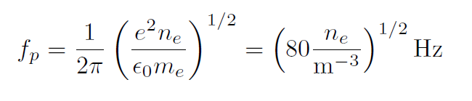
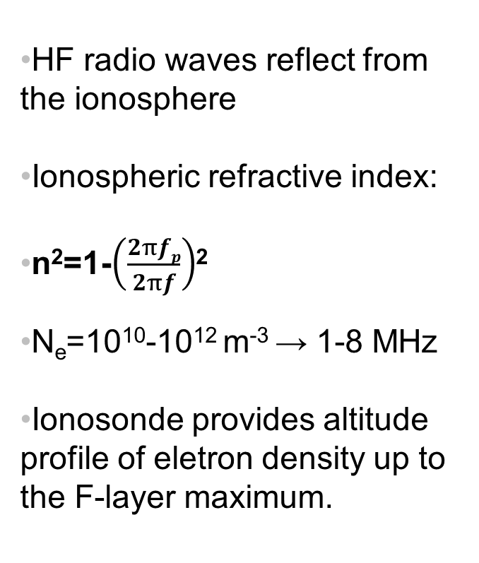
Support to TomoScand by ionosondes
HF radio waves reflect from the ionosphere
Ionospheric refractive index:
n²=1-$\left(\frac{2πfp}{2πf}\right)$²
N_{e}=10¹⁰-10¹² m⁻³ → 1-8 MHz
Ionosonde provides altitude profile of eletron density up to the F-layer maximum.
Figure: www-amateur-radio-wiki.net

Slide 23
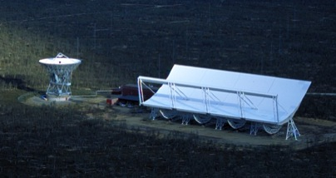
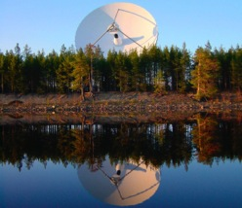
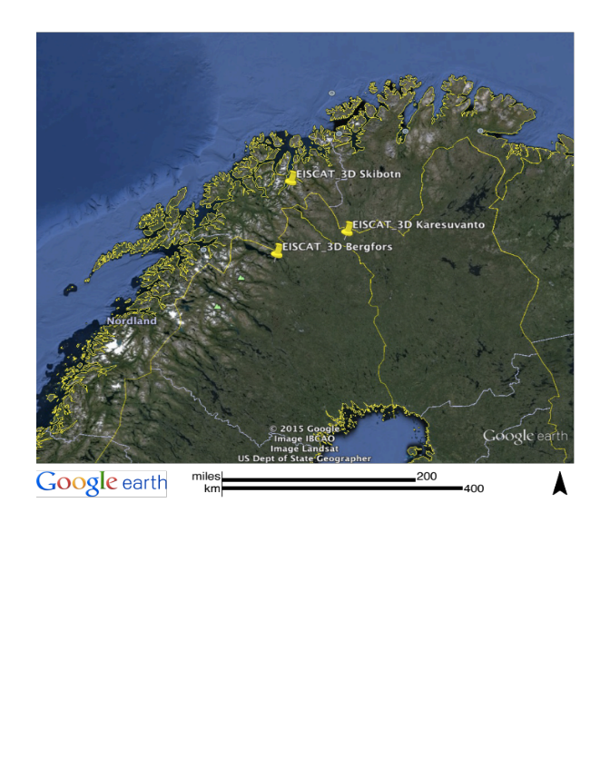
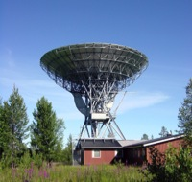
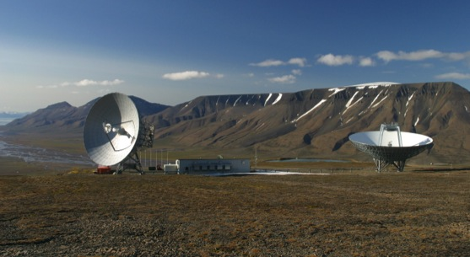
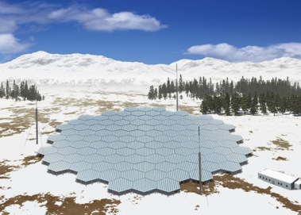
Validation with high power radars
EISCAT UHF
EISCAT_3D
EISCAT VHF
EISCAT SOD
EISCAT KIR
EISCAT Svalbard Radar
Slide by:
Esa Turunen
Sodankylä Geophysical Observatory
EISCAT_3D
EISCAT high power radars
-Transmitter in Tromsö
-Receivers in Kiruna and Sodankylä
-EISCAT_3D: 3D image on ionospheric properties
including plasma density and velocity
Image: NIPR

Slide 24
Societal impact & challenges

Slide 25
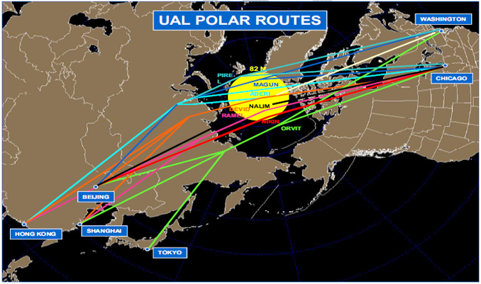
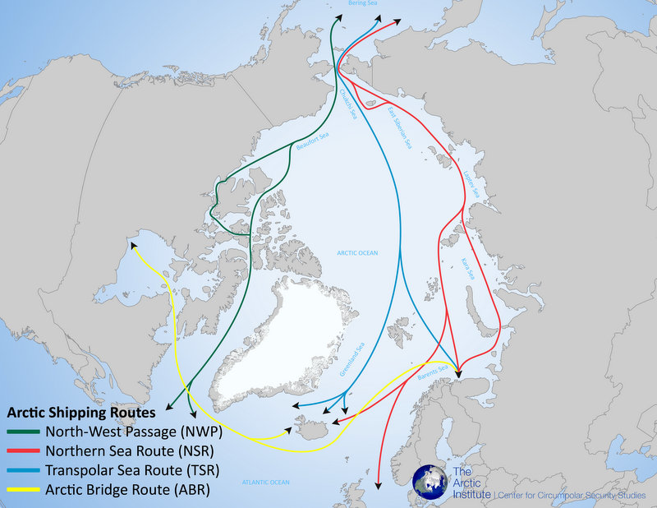
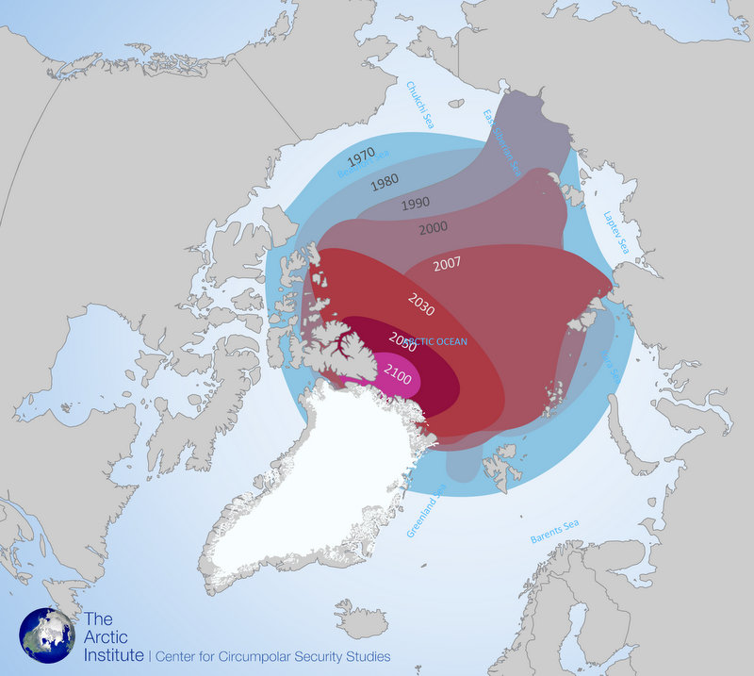
Why is this important?
Over the horizon communication with HF radio waves is used in arctic shipping and in aviation on polar routes
HF reflection conditions depend critically on ionospheric electron density conditions
Global warming opens new routes for artic shipping → significant reductions in time and costs
Figures:
Wikipedia
United Airlines
The Arctic Institute

Slide 26

Why forecasting space weather is so difficult?
The impact of a solar burst:
  X-rays and EUV come in 8 min
  Energetic particles in a few hours
  Solar wind structures (Coronal Mass Ejections) in 1-2 days
Information about the magnetic field topology is achieved from satellite recordings only 1 hour before it hits the Earth
Is the Coronal Mass Ejection travelling towards the Earth?
What is the status of the magnetosphere?
Which of the sunspot groups can launch a flare?
Are there coronal holes which generate high speed solar wind?
Is the magnetic structure of the mass ejection geoeffective?
Figure: NASA

Slide 27
Thanks for your attention!

